Slide 1

Lecture 4 – The Microcontroller
Expanding the functionality of the Arduino using hardware utilities provided by the atmega microcontroller

Slide 2
Last Session
UART Serial
Start using Serial.begin(baud);
Print using Serial.print(); and Serial.println();
Check buffer using Serial.available();
Read from the PC using Serial.read(); and Serial.readString();
Binary operators
Shift left <<
Shift right >>
Including libraries: #include <library.h>
I²C library – Wire
Start using Wire.begin();
Request data: Wire.requestFrom(address, bytes);
Read a byte: Wire.read();
SPI library - SPI
Start using SPI.begin();
Start transmission: SPI.beginTransaction();
Settings: SPISettings(freq, order, mode);
Transfer word: SPI.transfer16(output);
End transmission: SPI.endTransaction();

Slide 3
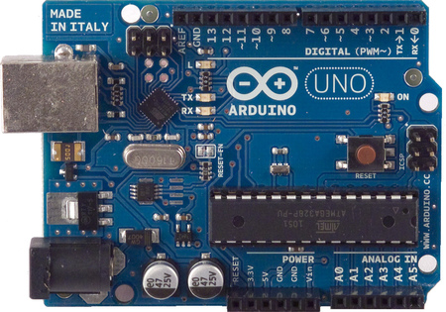
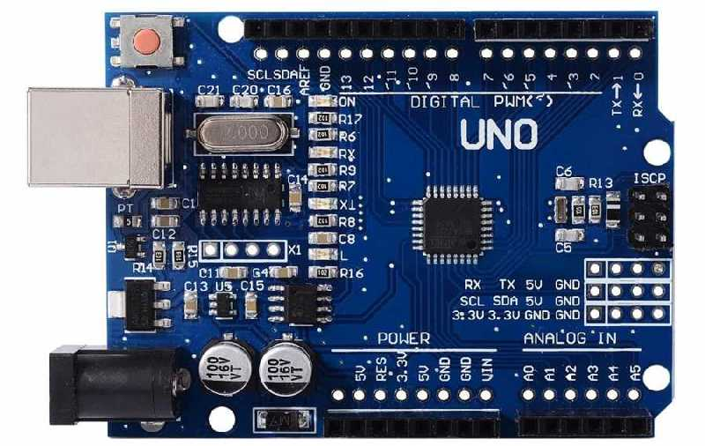
What is the Arduino’s Microcontroller?
The Arduino’s “brain” is the ATmega328P microcontroller chip
This microcontroller can be used on its own, without any of the extra components on the Arduino board
All the extra components just make it easier to interface with the Arduino
For example, the board has a serial programming chip built-in to make programming the microcontroller easy
“Genuino”
“Fakeduino”

Slide 4
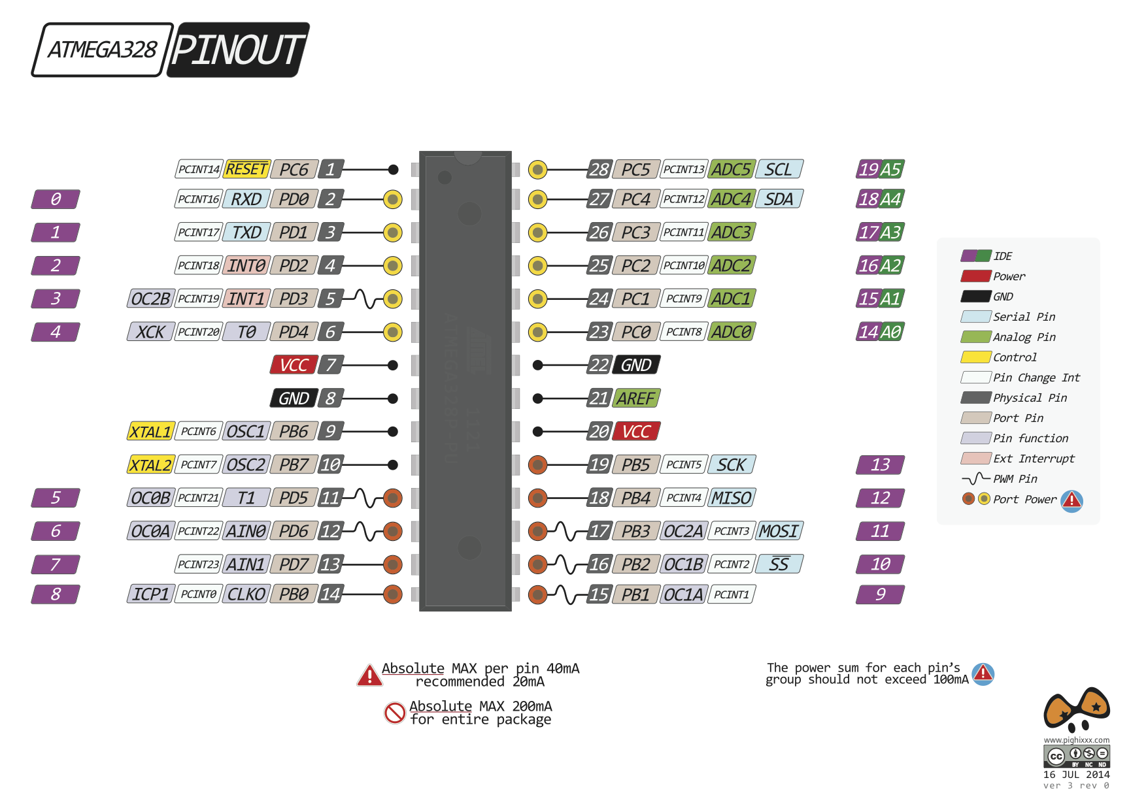
ATmega328P Microcontroller
Some features to note:
Three input/output “ports”
Parallel ports B, C and D
You write a binary number to the port instead of setting individual pins high or low
It’s generally a bad idea to play with Port D, since it’s used to program the Arduino!
Port C is the Analogue pins (A0-A5) – these can actually also be used as digital pins 14-19!
Some useful EEPROM memory (inside the chip)
Two interrupt pins (D2 and D3)

Slide 5
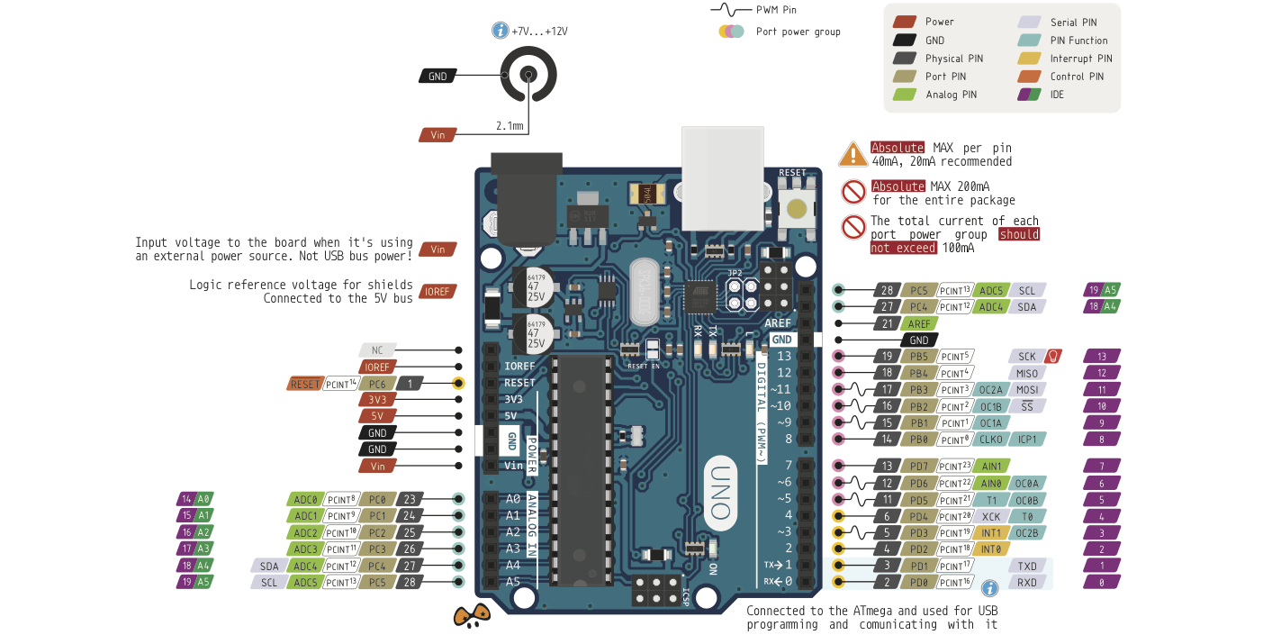
ATmega328P Functions on Arduino UNO
Interrupt Pins
Port B
Port C
Port D

Slide 6
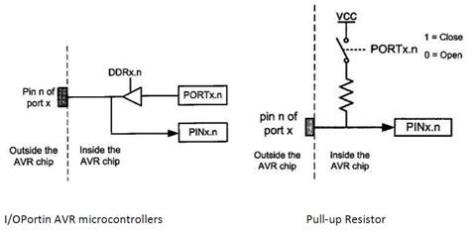
Port Manipulation
Remember digitalRead, digitalWrite, pinMode etc? We can forget about them!
We only need to deal with three registers – places where we can store a binary value – eg. for Port B:
DDRB – “data direction register” - 0 = input and 1 = output
PORTB – data register for Port B (also sets the pull-up resistor for inputs)
PINB – pin status register (read only)
The register value (in binary) is split across the I/O pins bit by bit (example for the value 107)
Port B only controls 6 pins (B6 and B7
PORTB: | 0 | 1 | 1 | 0 | 1 | 0 | 1 | 1
Bit: | B7 | B6 | B5 | B4 | B3 | B2 | B1 | B0
Pin: | - | - | 13 | 12 | 11 | 10 | 9 | 8

Slide 7
Back to the Blink Example
Believe it or not, this code does exactly the same thing as the Blink example, using ports
pinMask variable contains a single 1 in position 5 – this corresponds to bit 5 (pin 13)
B at the beginning of pinMask means “binary”
DDRB set by using the bitwise OR operator | – this sets the value of bit 5 high without affecting the other bits
PORTB set using the bitwise XOR (exclusive-OR) operator ^ - this toggles the value of bit 5 without affecting the other bits
Note: it’s good practice to use bit masks where possible to not interfere with other pins – but you don’t have to!
byte pinMask = B00100000;
void setup() {
DDRB = DDRB | pinMask;
}
void loop() {
PORTB = PORTB ^ pinMask;
delay(1000);
}

Slide 8
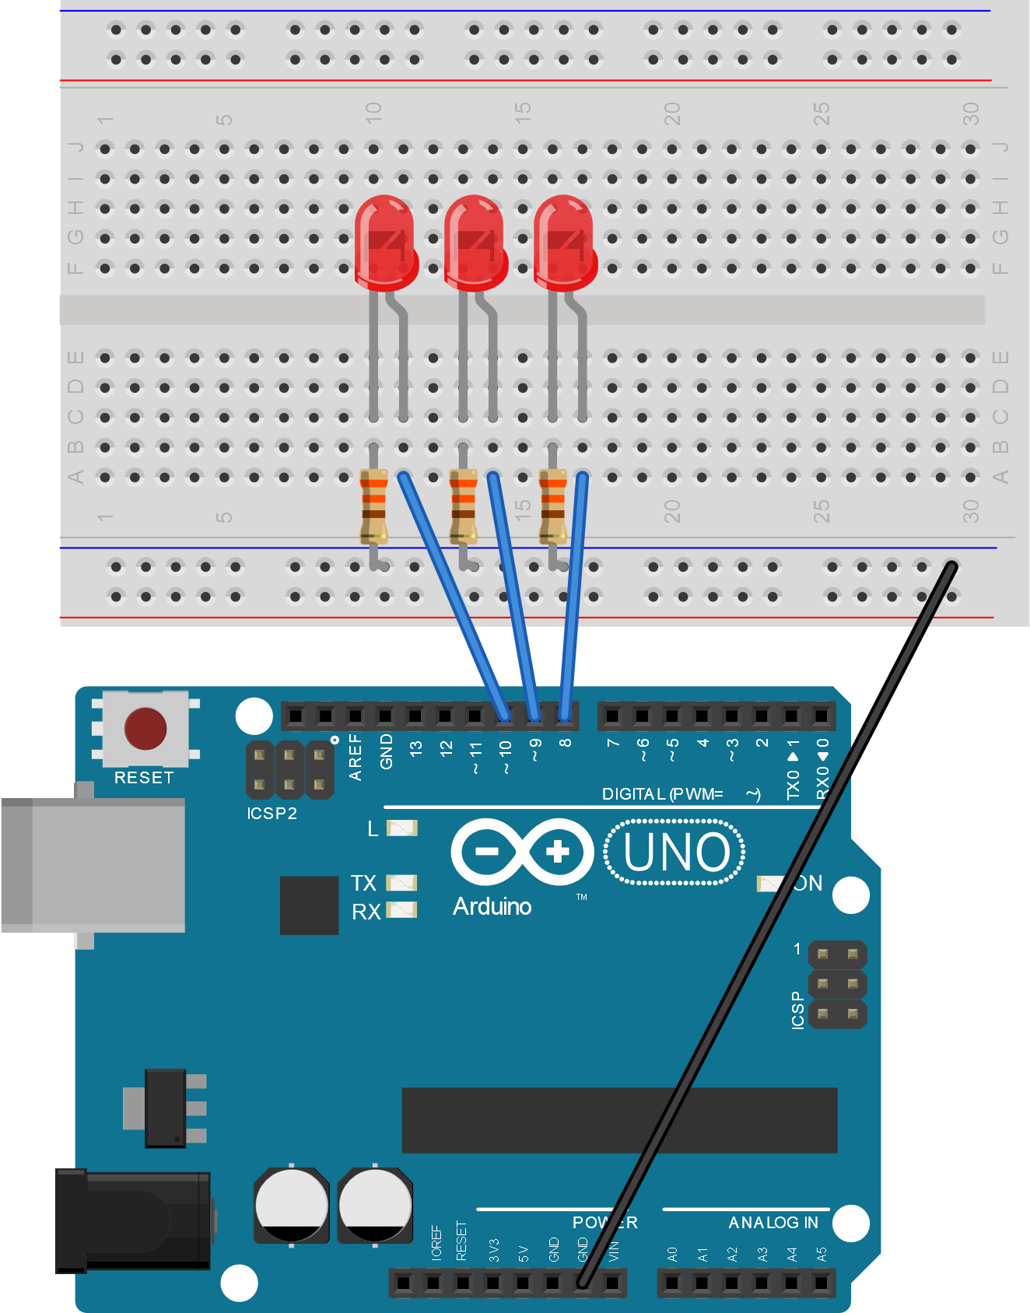
A Binary Counter
Something that’s very easy with ports and more complicated without them
Build this circuit now →
We want to write a program that counts binary states on the three LEDS:
State | Binary
0 | 000
1 | 001
2 | 010
3 | 011
4 | 100
5 | 101
6 | 110
7 | 111

Slide 9
Why Bother Using Port Manipulation?
The next three slides contain three code examples that all do exactly the same thing
Look at what each code example is doing, and the length of the code
See how using ports means we can write very simple code to implement our binary counter

Slide 10
Binary Counter Code – The “Simple” Way
We are not going to run this code!
Look at how it’s handling outputting to the three LEDs – using digitalWrites and if statements to convert to binary
This requires a lot of repetitive code
There are definitely better ways to do it!
int led1 = 8;
int led2 = 9;
int led3 = 10;
int counter = 0;
int state1 = 0;
int state2 = 0;
int state3 = 0;
void setup() {
pinMode(led1, OUTPUT);
pinMode(led2, OUTPUT);
pinMode(led3, OUTPUT);
digitalWrite(led1, LOW);
digitalWrite(led2, LOW);
digitalWrite(led3, LOW);
}
void loop() {
counter +=1;
if (counter == 8){
counter = 0;
}
int temp = counter;
if(temp>=4){
digitalWrite(led3, HIGH);
temp = temp - 4;
}
else{
digitalWrite(led3, LOW);
}
if(temp>=2){
digitalWrite(led2, HIGH);
temp = temp - 2;
}
else{
digitalWrite(led2, LOW);
}
if(temp>=1){
digitalWrite(led1, HIGH);
temp = temp - 1;
}
else{
digitalWrite(led1, LOW);
}
delay(1000);
}

Slide 11
Binary Counter Code – The “Sneaky” Way
This code is shorter, but we still won’t bother to run it
Look at how much simpler the output code is – we are still using digitalWrite but now we are using bitwise operators to extract bits from counter
counter & 1 uses the bitwise AND operator
The value 1 here is basically a mask that’s being used to extract the first bit from the binary representation of counter
The other masks are 2 and 4 – this is because binary is base 2:
2⁰ = 1, 2¹ = 2, 2³ = 4
This is pretty close to what we do by manipulating the ports, but it’s a very inefficient and indirect method...
int led1 = 8;
int led2 = 9;
int led3 = 10;
int counter = 0;
void setup() {
pinMode(led1, OUTPUT);
pinMode(led2, OUTPUT);
pinMode(led3, OUTPUT);
digitalWrite(led1, LOW);
digitalWrite(led2, LOW);
digitalWrite(led3, LOW);
}
void loop() {
counter +=1;
if (counter == 8){
counter = 0;
}
digitalWrite(led1, counter & 1);
digitalWrite(led2, counter & 2);
digitalWrite(led3, counter & 4);
delay(1000);
}

Slide 12
Binary Counter Code Using Ports
Very simple! Try this code
DDRB set so that pins 8, 9 and 10 (B0, B1, B2) are set as outputs
We directly manipulate the value of PORTB – since this is directly connected to the pins, changes are instantaneous
Increasing the value of PORTB forever will keep the lowest three bits (connected to our LEDs) counting up from 0 to 7 forever
The fastest and most efficient way we can do this!
Notice that we haven’t bothered using bit masks
What happens to the LEDs if you press the RESET button on the Arduino?
void setup() {
DDRB = B00000111;
}
void loop() {
PORTB += 1;
delay(1000);
}

Slide 13
Memory
In our binary counter code, the Arduino starts counting up from zero every time it resets
It can be useful to be able to remember things when the Arduino resets
The ATmega328P has 1024 bytes of EEPROM (Electronically-Erasable Programmable Read-Only Memory) – this is a “non-volatile” memory type, so doesn’t lose its content when the microcontroller is switched off or reset
We can access the EEPROM ourselves in our programs when we need persistent storage, using the EEPROM library

Slide 14
Reading from EEPROM
In order to use the EEPROM features, the EEPROM library must be #included
Values are read from the memory using EEPROM.read(address) giving the memory address as an integer between 0 and 1023
This code uses a for loop to print the numerical values of every memory address to the serial monitor in turn
What’s stored in your EEPROM?
Probably a lot of 255s and whatever anyone else has thrown in there – have a look?
Can you make the program ignore any addresses whose value is 255?
#include <EEPROM.h>
void setup() {
Serial.begin(9600);
}
void loop() {
int i;
for( i=0; i<1024; i++ ){
Serial.print(i);
Serial.print(": ");
Serial.println(EEPROM.read(i));
}
delay(10000);
}

Slide 15
Writing to EEPROM
This code won’t noticeably do anything!
Writes the values 0 to 255 into the EEPROM 4 times using EEPROM.write(address, value)
Note the use of the bitwise AND operator again – can you work out what it’s doing?
Once you’ve run this code, run the code from the previous slide again and see what’s now in the EEPROM
How could we use the EEPROM to remember the last state of our binary counter?
#include <EEPROM.h>
void setup() {
int i = 0;
byte value;
for( i=0; i<1024; i++){
value = i & 255;
EEPROM.write(i, value);
}
}
void loop() {
}

Slide 16
Binary Counter Code With EEPROM
This is our binary counter code using ports, with added code to use the EEPROM
Uses EEPROM address 0 – set up as a const int
Read the value into PORTB from the EEPROM during setup
Write the value from PORTB to the EEPROM in every loop
Now what happens when the Arduino is reset?
Can you add a switch to your circuit to reset the counter to zero? (Hint: go back to the slides from Session 2)
#include <EEPROM.h>
const int address = 0;
void setup() {
DDRB = B00000111;
PORTB = EEPROM.read(address);
}
void loop() {
delay(1000);
PORTB += 1;
EEPROM.write(address, PORTB);
}

Slide 17
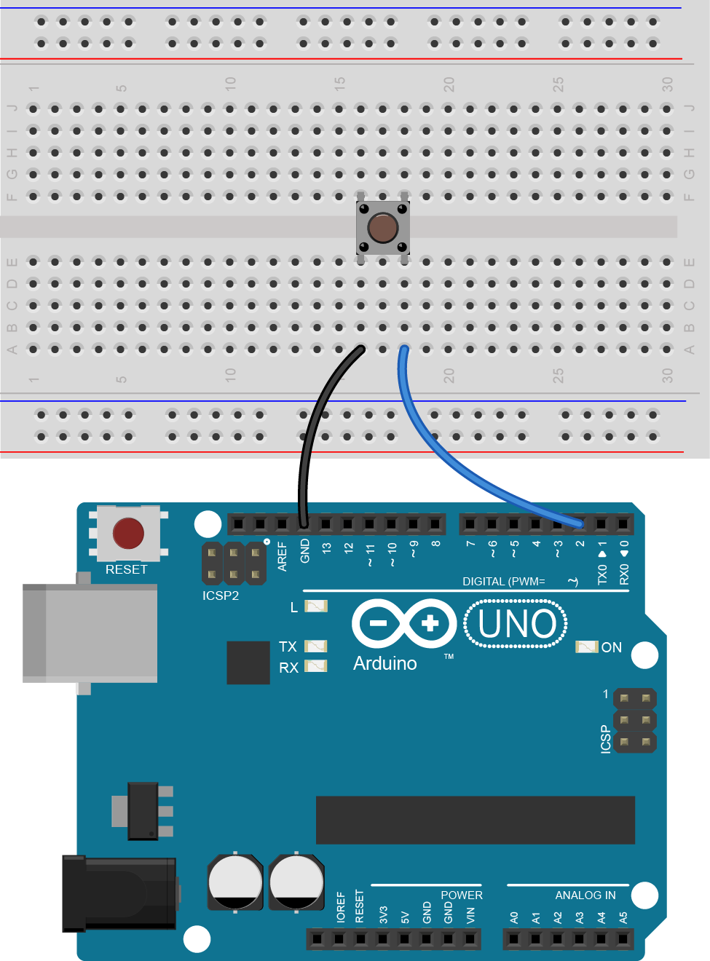
Back to Buttons
Remember this simple circuit from Session 2?
We’re going to look at a better, more efficient way of implementing a button using interrupts
We’ll use our button to reset our counter

Slide 18
Interrupts
These do pretty much do exactly what you think they might do!
Interrupts break the usual flow of code whenever a specific event happens, and execute a specific function in the code before returning to wherever it left off
With the exception of other interrupts! (eg, delay()...)
The ATmega328P supports two different types of interrupts
Pin change interrupt – causes the interrupt when any of the input pins changes from high to low – but it’s up to you to figure out what happened
External interrupt – the ATmega328P has two hardware-based interrupt pins which can be used as inputs - these are more useful since each interrupt is identifiable and can call its own function
We’ll look at external interrupts, as they are more useful, and utilise the hardware in the ATmega328P

Slide 19
A (Very Basic) Crash Course in Functions
To use interrupts we’ll need to make our own functions
Functions are just blocks of code which can be called and run from elsewhere in the code
You’ve already seen some functions – setup() and loop()
In this example, we’ve made a function called function1() – we won’t worry about the void bit or the brackets – just accept they need to be there
Your code goes between the curly brackets
We can run function1 by typing function1();
void loop() {
//I am a function!
//You can call your own functions too...
function1();
}
void function1() {
//Put some stuff to do here!
}

Slide 20

Adding a Button to the Binary Counter
Add a button to your circuit as shown here
The two external interrupts are supported on the Arduino’s pin 2 (INT0) and pin 3 (INT1)
Here, we are using INT0 on pin 2
The button circuit should be familiar from Session 2

Slide 21
Binary Counter Code with Interrupts
Our interrupt pin (pin 2) needs to be set as an input – we are using INPUT_PULLUP
Set the interrupt up using attachInterrupt(INT#, function, edge);
Whenever the switch is pressed the interrupt will call our function buttonPress, and PORTB will be set to zero.
Can you get rid of the pinMode line by initialising pin 2 using port manipulation? Try to avoid setting D0 as an output!
#include <EEPROM.h>
const int address = 0;
void setup() {
pinMode(2, INPUT_PULLUP);
attachInterrupt(0, buttonPress, FALLING);
DDRB = B00000111;
PORTB = EEPROM.read(address);
}
void loop() {
delay(1000);
PORTB += 1;
EEPROM.write(address, PORTB);
}
void buttonPress(){
PORTB = 0;
}

Slide 22
Using Interrupts – Things To Remember
If you want to set a variable inside an interrupt, it will declared as being volatile (ie. volatile int num1) - this tells the compiler that it should be declared in RAM so everything (including our interrupt) can access it
There are functions we’ve used in previous sessions that require the use of interrupts even though we haven’t considered it – functions like delay() won’t work inside an interrupt
Interrupts are executed and then return to wherever the code was just before the interrupt – this might be in a strange place, so be careful that whatever you do won’t break any of your program’s logic

Slide 23
Plenary
Port Manipulation
Port Registers:
DDRx – Data Direction Register for Port x
0 = Input, 1 = Output
PORTx – Port Data Register for Port x
Also sets internal pullup resistor for inputs
PINx – Pin State Register for Port x
Used for reading inputs and monitoring pin states
Bitwise Operations:
A & B – A AND B (masking)
A | B – A OR B (selective setting)
A ^ B – A XOR B (toggle)
~A – NOT A (inverting)
EEPROM
#include <EEPROM.h>
1024 bytes of storage
Read: EEPROM.read(address);
Write: EEPROM.write(address, value);
Functions
Define using void functionName(){ }
Call using functionName();
Interrupts (External)
INT0 on pin 2 and INT1 on pin 3
Attach interrupt to an input pin using attachInterrupt(INT#, function, edge);

Slide 24
Final Challenges
Try some of the following:
Make your binary counter bigger by adding more LEDs to use all six bits of Port B
Adapt your binary counter to switch between the seven possible colours of an RGB LED
Use the EEPROM to store a string from the user that is printed to Serial when the Arduino is turned on
Make a reaction timer using an LED and a button using interrupts, and use EEPROM to store the high score
Use the tone library from Session 2 with a buzzer and an interrupt to make a doorbell that rings when a button is pressed

